Slide 1
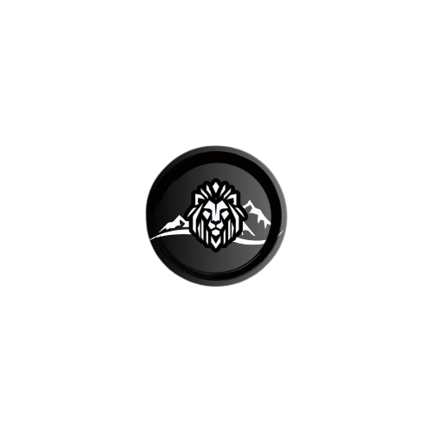
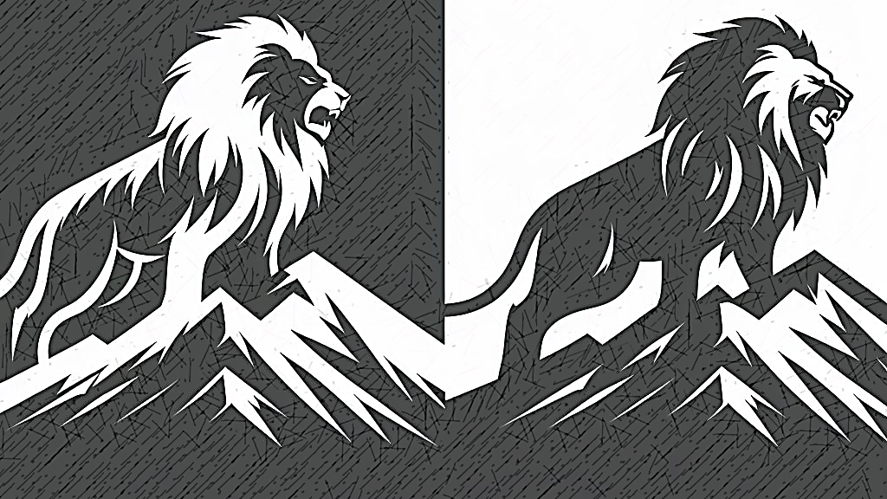
Mountain Lion Studios
- A Software Development Group -

Slide 2
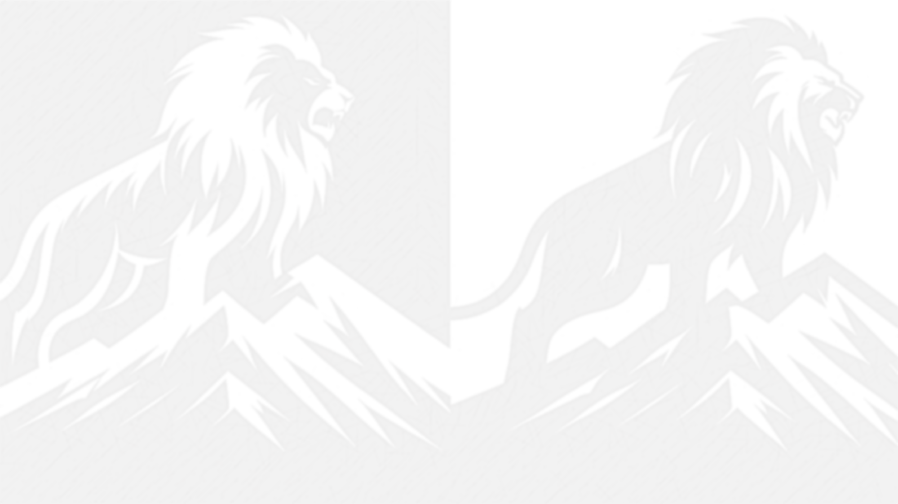
Introduction
Mountain Lion Studios is built and inspired on the idea of a mountain and a lion
It is mainly a Software Studio driven by game development
The Brand is meant to follow a few simple design rules, neutral colors and very few elements, minimalistic

Slide 3
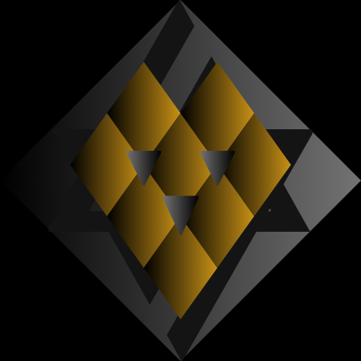
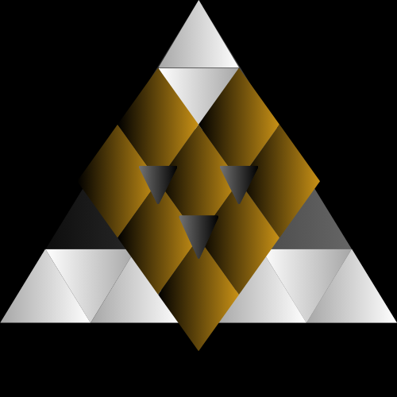
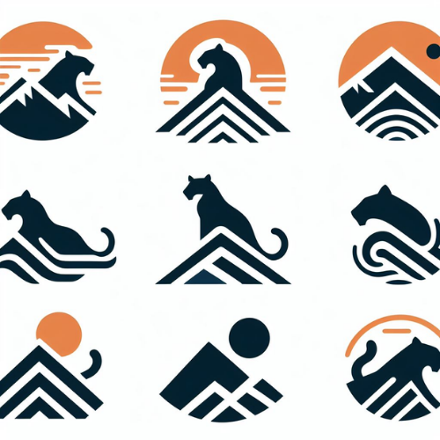
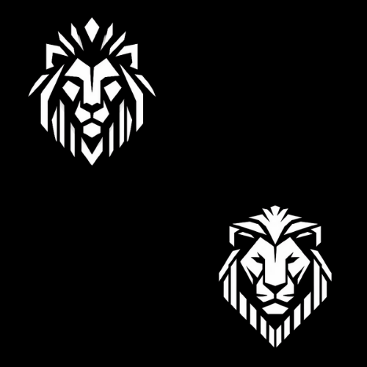
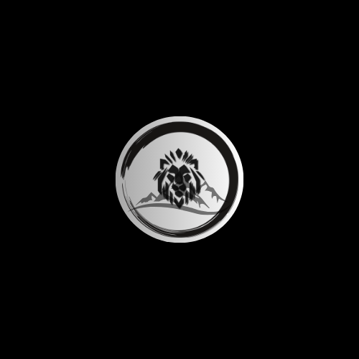
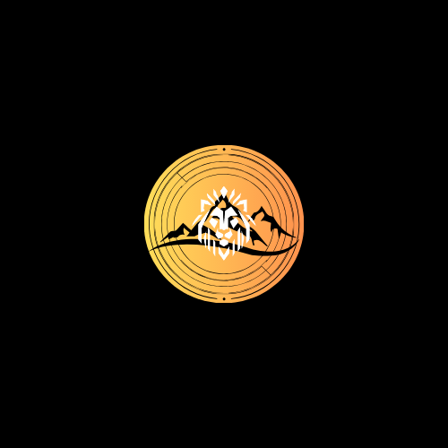
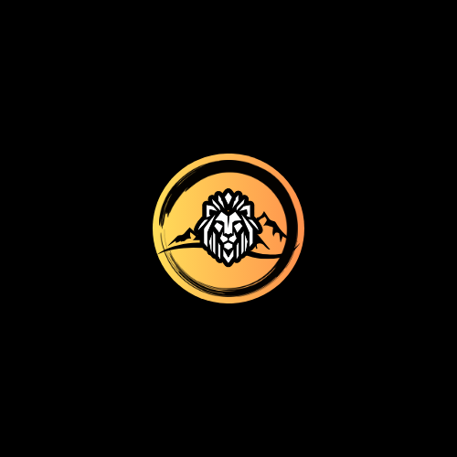
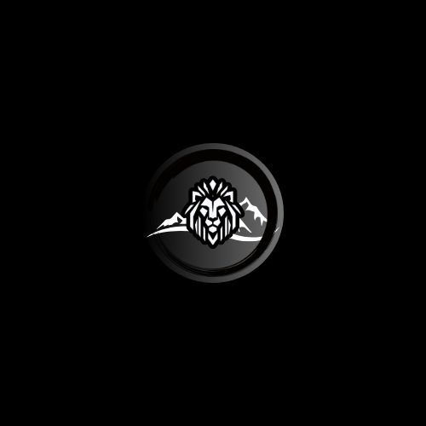
Logo Design – Process Samples
Phase I
Phase II
Phase III
Phase IV

Slide 4
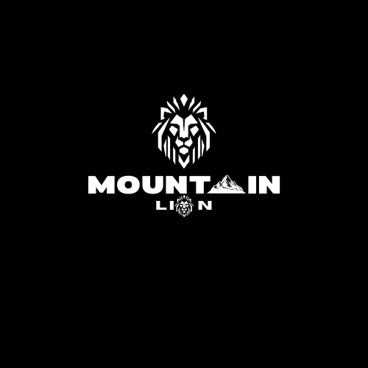
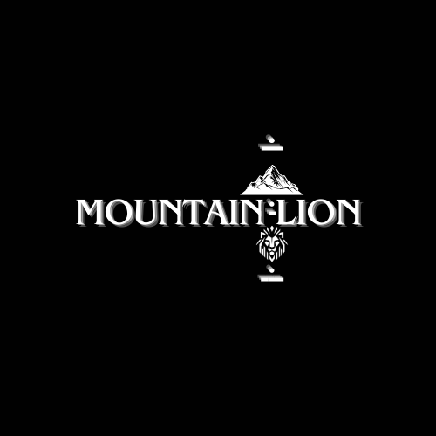
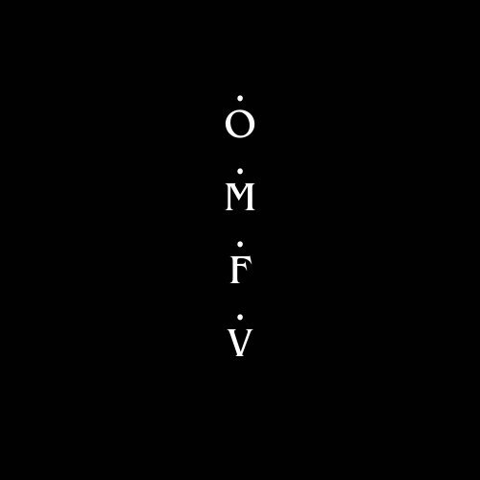
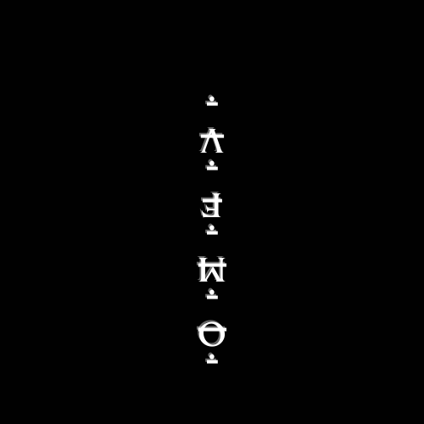
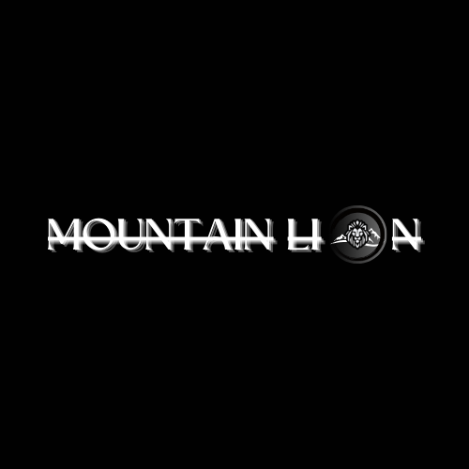
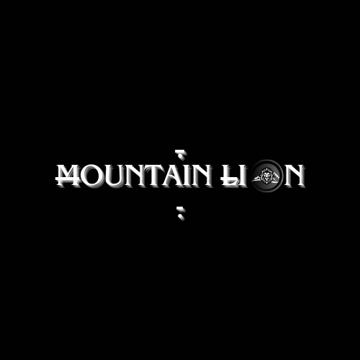
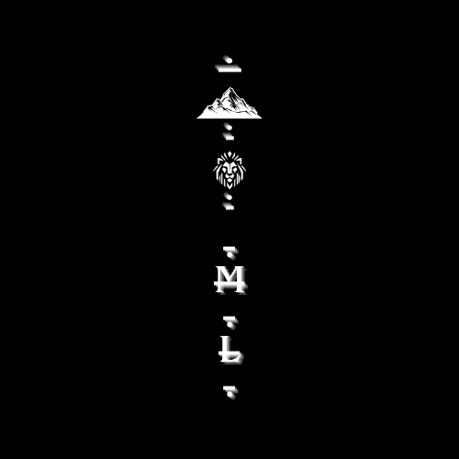
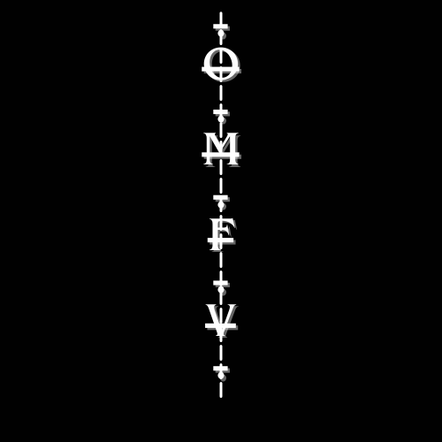
Typography Design – Process Samples
Phase I
Phase II
Phase III
Phase IV

Slide 5
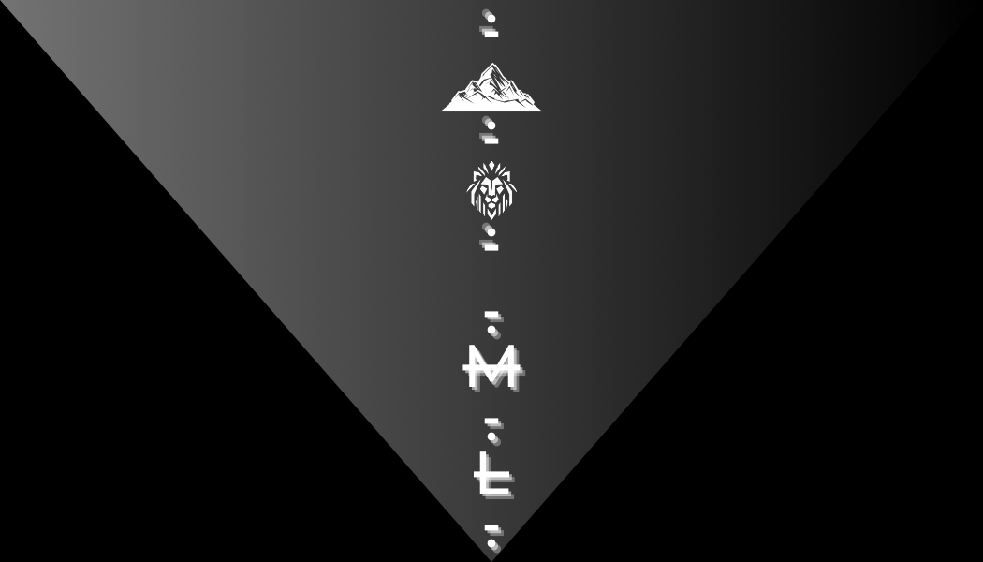
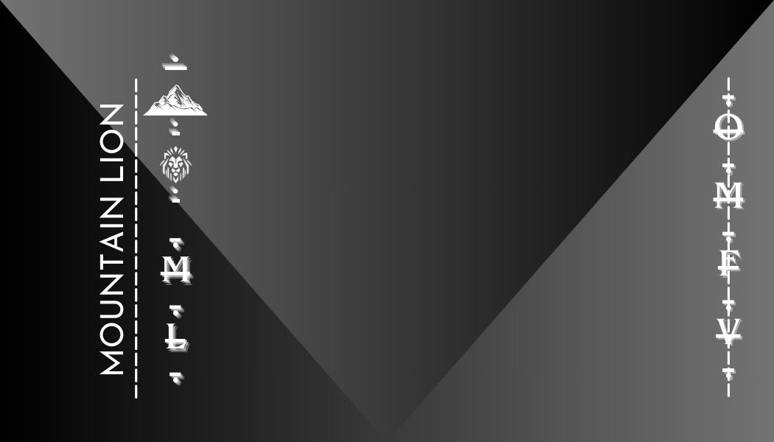
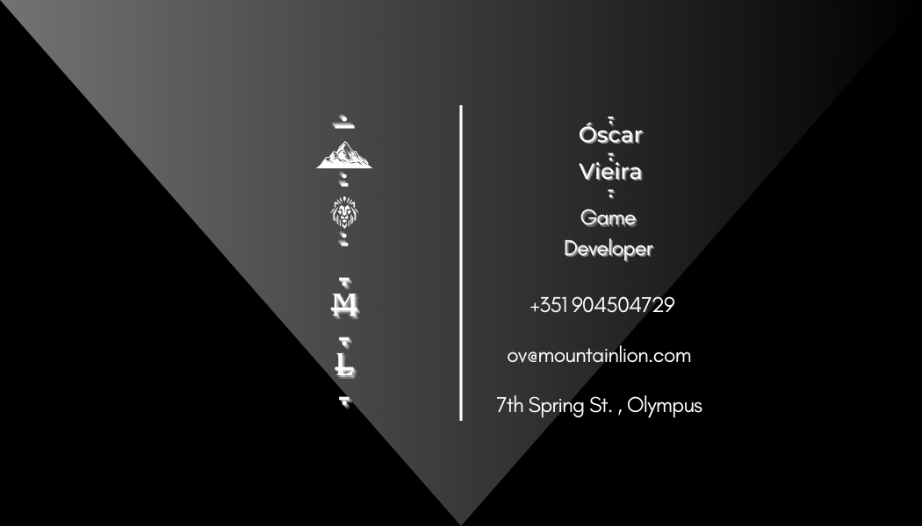
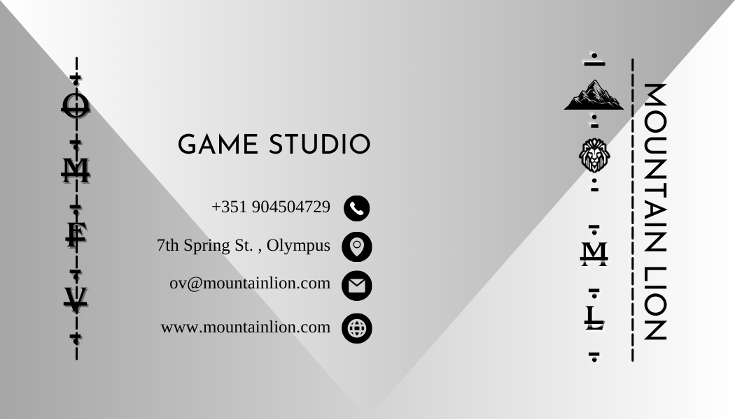
Business Card Design – Process Samples
Phase I
Phase II

Slide 6
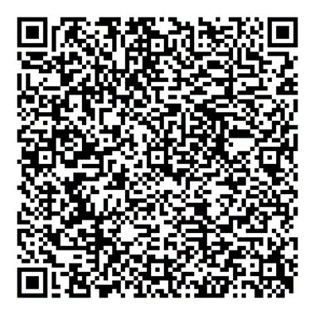
Relevant Links & Insights
Canva:
1.https://www.canva.com/design/DAFz47i40Fk/GvOwvbWFr2f3UyPrHPAnVA/edit?utm_content=DAFz47i40Fk&utm_campaign=designshare&utm_medium=link2&utm_source=sharebutton
2.https://www.canva.com/design/DAF0is-jnJ0/ndrvZaHshiDvauzxqM_ZDg/edit?utm_content=DAF0is-jnJ0&utm_campaign=designshare&utm_medium=link2&utm_source=sharebutton
3.https://www.canva.com/design/DAF1k2xvnxs/7x5dAYb36IU2b0Yi93e85g/edit?utm_content=DAF1k2xvnxs&utm_campaign=designshare&utm_medium=link2&utm_source=sharebutton
Wix:
1. Desktop: https://oscarmiguel96.wixsite.com/mountain-lion
2. Mobile:

Slide 7
Conclusion
Mountain Lion Studios is not something that can be built in a month or two
The drive is important but alone will not get the job done, lots of effort and work go into a Studio
Although the Brand is meant to follow a few simple design rules, it still takes a lot of time to develop it, limitations and constrains can at times be difficult to work with

